Slide 1
Electrical
and Electronics science
First year
Computer Science and Engineering
Dr. Shakti Singh
ASSISTANT PROFESSOR
ELECTRCIAL AND INSTRUMENATION
ENGINEERING DEPARTMENT
@shakti.singh@thapar.edu

Slide 2
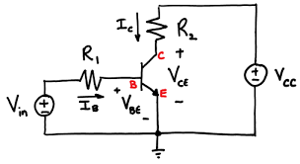
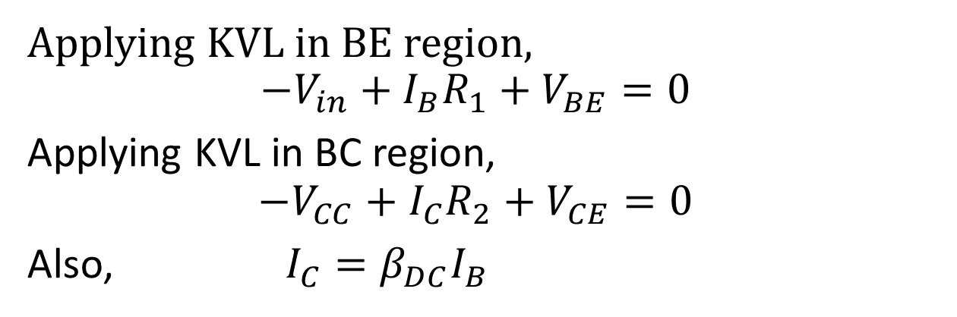
BJT Operating Equations
Applying KVL in BE region,
$${−V}_{in}+I_{B}R_{1}+V_{BE}=0$$
Applying KVL in BC region,
$$−V_{CC}+I_{C}R_{2}+V_{CE}=0$$
Also, $I_{C}=β_{DC}I_{B}$

Slide 3
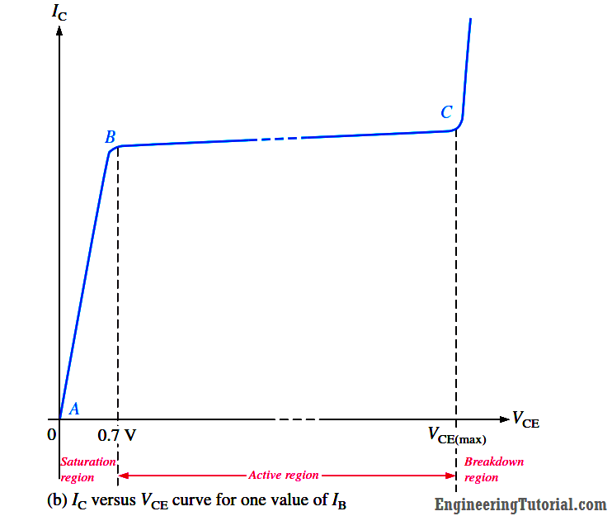
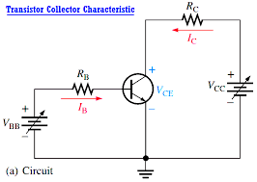
BJT Characteristic

Slide 4
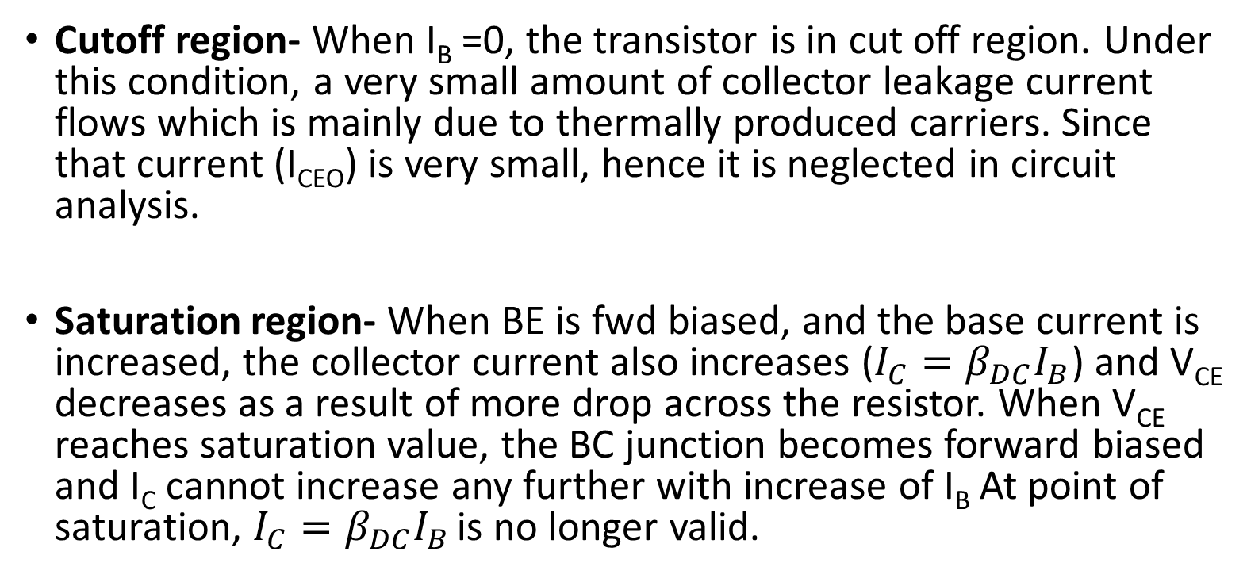
BJT Characteristic
Cutoff region- When I_{B} =0, the transistor is in cut off region. Under this condition, a very small amount of collector leakage current flows which is mainly due to thermally produced carriers. Since that current (I_{CEO}) is very small, hence it is neglected in circuit analysis.
Saturation region- When BE is fwd biased, and the base current is increased, the collector current also increases ($I_{C}=β_{DC}I_{B}$) and V_{CE} decreases as a result of more drop across the resistor. When V_{CE} reaches saturation value, the BC junction becomes forward biased and I_{C} cannot increase any further with increase of I_{B} At point of saturation, $I_{C}=β_{DC}I_{B}$ is no longer valid.

Slide 5
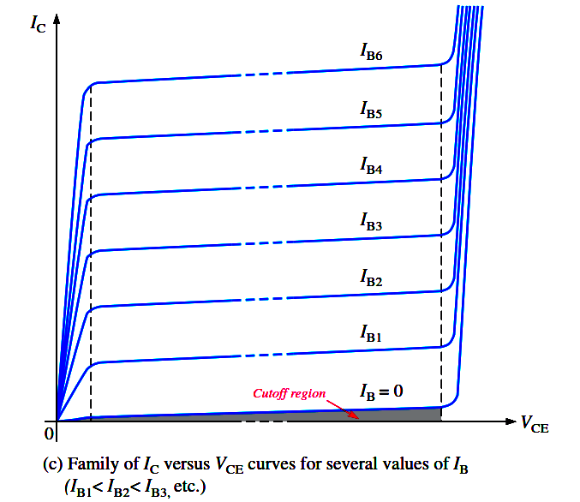

Slide 6
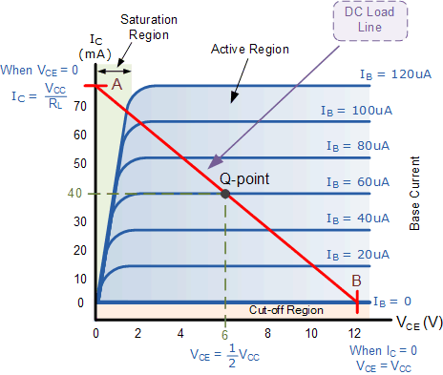
DC Load Line and Q point

Slide 7
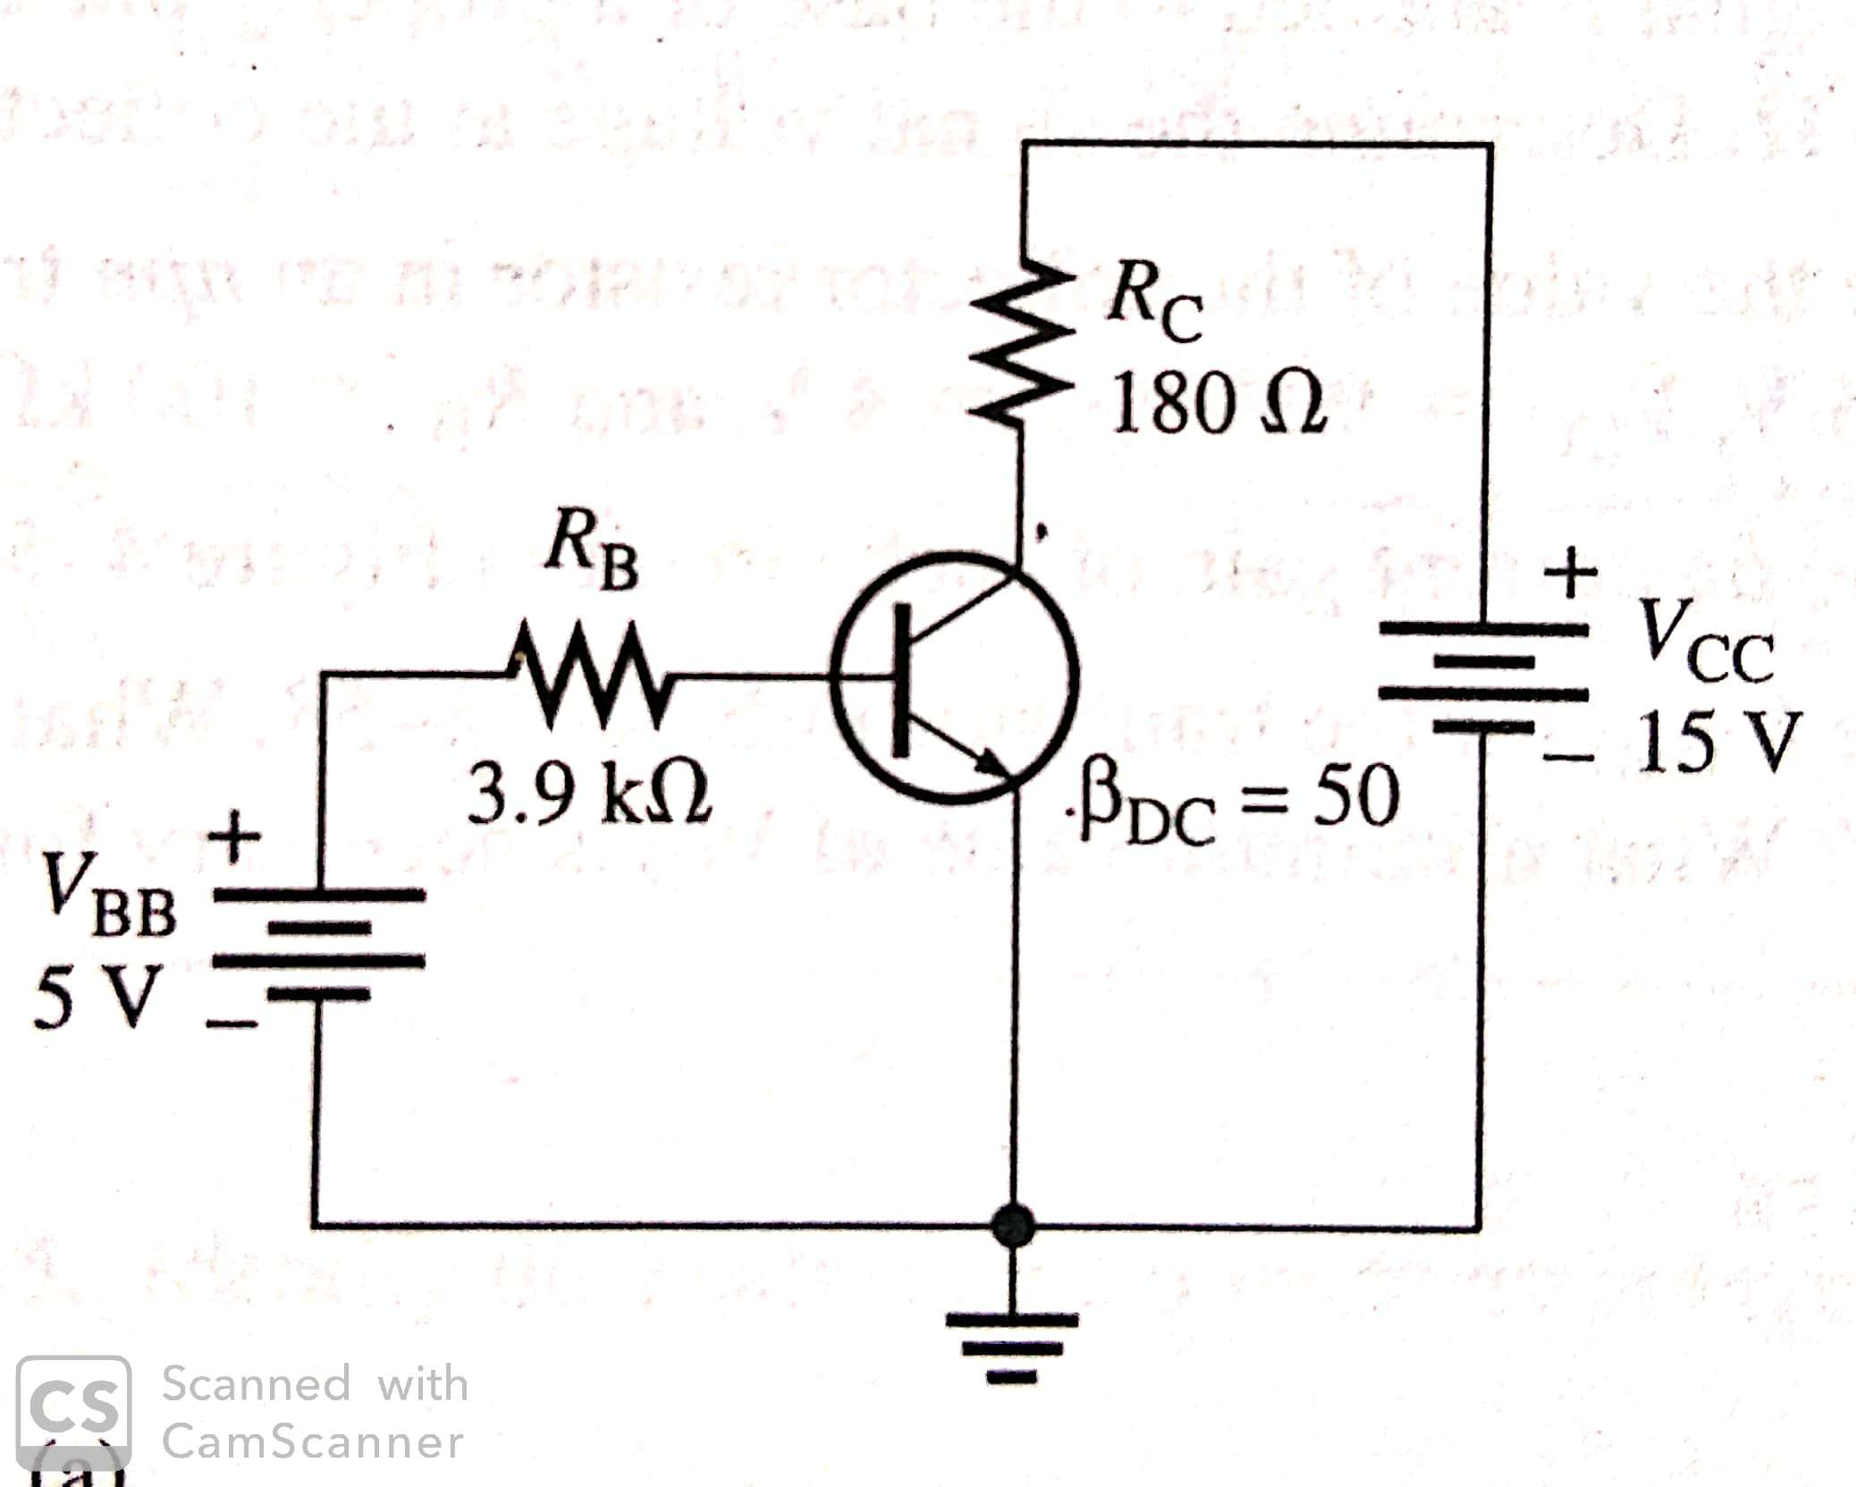
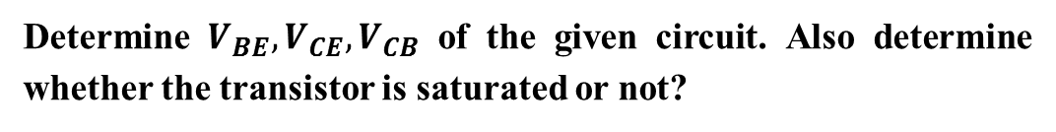
Numerical
Determine $V_{BE}, V_{CE}, V_{CB}$ of the given circuit. Also determine whether the transistor is saturated or not?

Slide 8
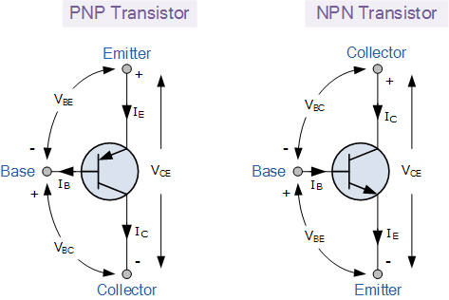
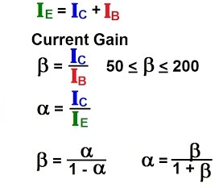
Transistor Currents
I_{E}=I_{C}+I_{B.}
Alpha and Beta Current Gain.

Slide 9
BJT Operating Equations
Applying KVL in BE region,
$${−V}_{in}+I_{B}R_{1}+V_{BE}=0$$
Applying KVL in BC region,
$$−V_{CC}+I_{C}R_{2}+V_{CE}=0$$
Also, $I_{C}=β_{DC}I_{B}$

Slide 10
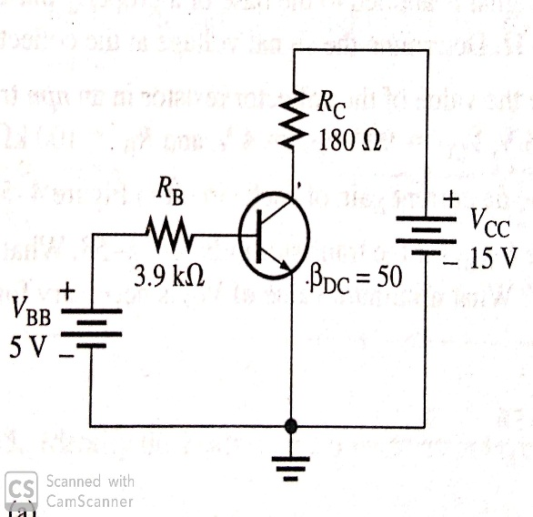
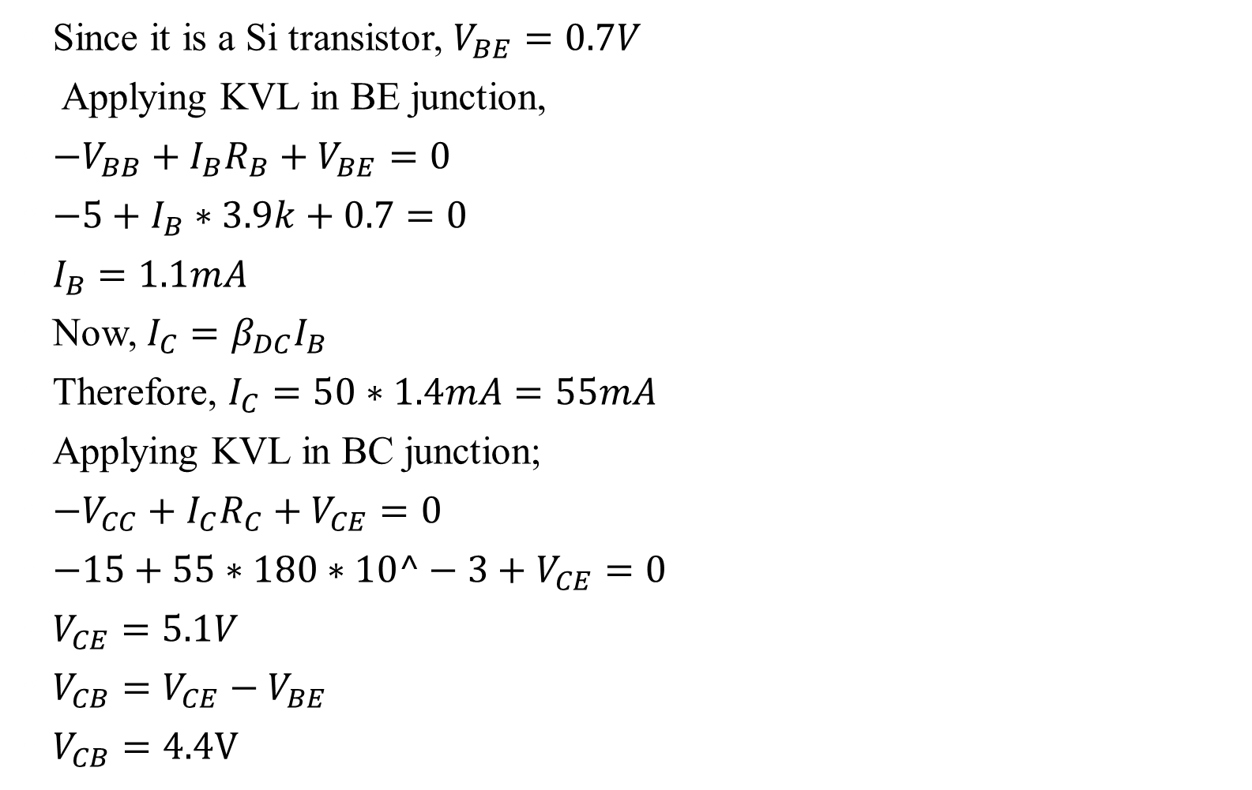
Solution 1
Since it is a Si transistor, $V_{BE}=0.7V$
Applying KVL in BE junction,
${−V}_{BB}+I_{B}R_{B}+V_{BE}=0$
$−5+I_{B}∗3.9k+0.7=0$
$I_{B}=1.1mA$
Now, $I_{C}=β_{DC}I_{B}$
Therefore, $I_{C}=50∗1.4mA=55mA$
Applying KVL in BC junction;
$−V_{CC}+I_{C}R_{C}+V_{CE}=0$
$−15+55∗180∗10^−3+V_{CE}=0$
$V_{CE}=5.1V$
$V_{CB}=V_{CE}−V_{BE}$
$V_{CB}=4.4V$

Slide 11
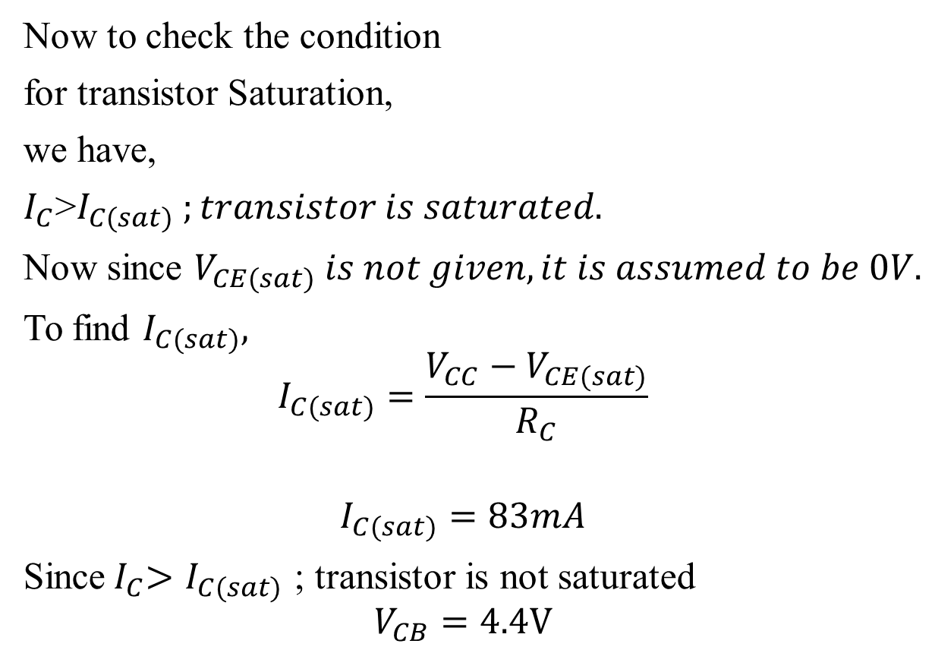
Solution 1
Now to check the condition
for transistor Saturation,
we have,
$I_{C}$>$I_{C(sat)} ;transistor is saturated.$
Now since $V_{CE(sat)} is not given, it is assumed to be 0V.$
To find $I_{C(sat)},$
$$I_{C(sat)}=\frac{V_{CC}−V_{CE(sat)}}{R_{C}}$$
$$I_{C(sat)}=83mA$$
Since${ I}_{C}>I_{C(sat)}$ ; transistor is not saturated
$$V_{CB}=4.4V$$

